Slide 1

Terrain-Based Optimal Evacuation Route Search System for Securing the Golden Time
20190605 Inho Jung
20230350 Younwoo Sung
20250143 Sugi Kim

Slide 2
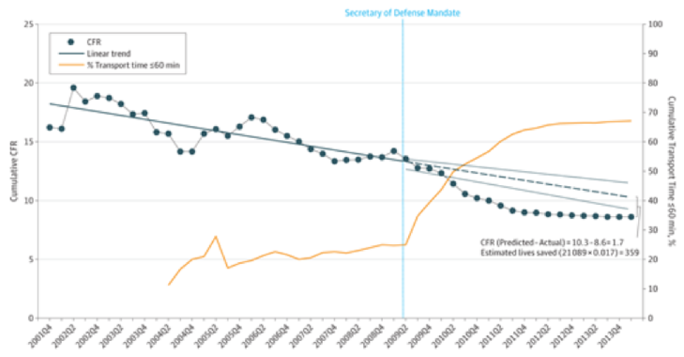
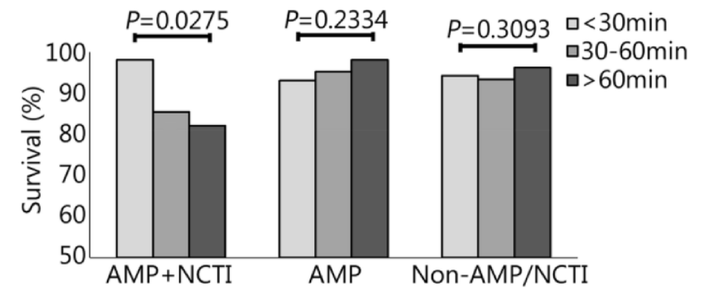
Introduction
Mortality rate decreases with shorter transit times
Mortality rate over transport time when the degree of injury varies

Slide 3
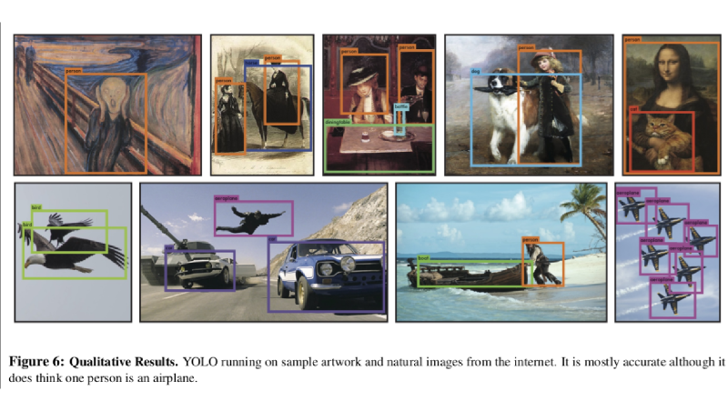
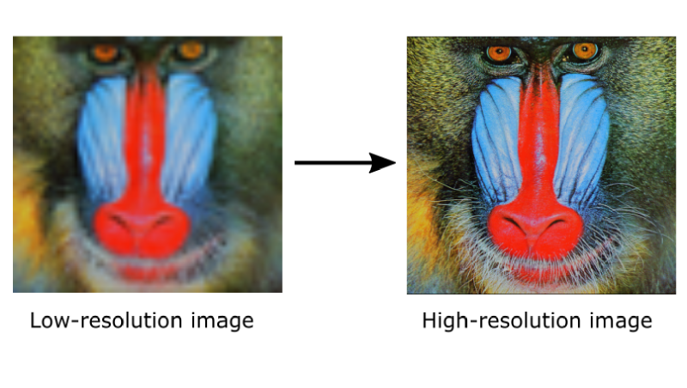
Technology Research for Shapefile Extraction
Segmentation - Object Detection
SuperResoltuion - Real-ESRGAN
Add a quick description of each thing, with enough context to understand what’s up.
Keep ‘em short and sweet, so they’re easy to scan and remember.

Slide 4
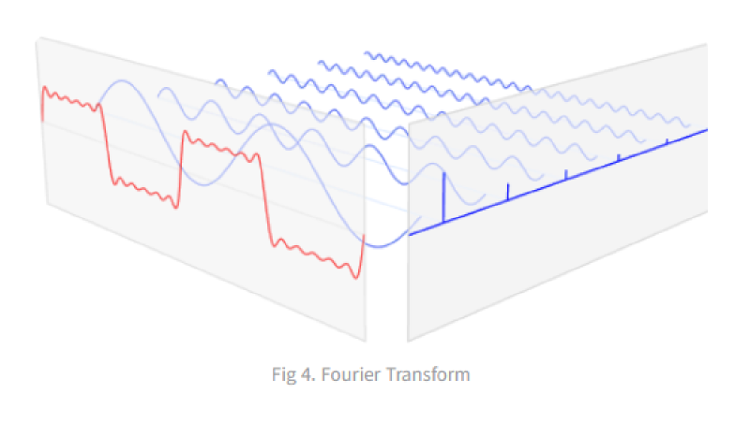
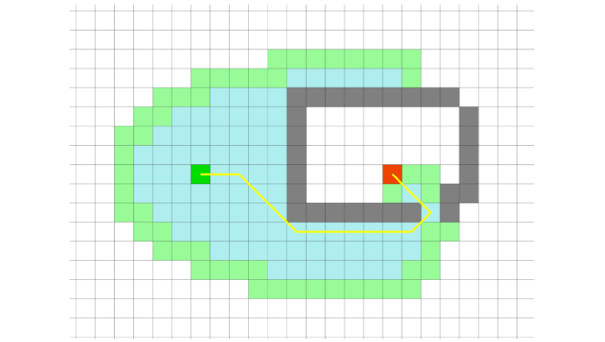
Technology Research for PathFinding
DEM SuperResoltion - DCT Transform
Shortest Path Search - A* Algorithm
Add a quick description of each thing, with enough context to understand what’s up.
Shortest Path Search - A* Algorithm

Slide 5
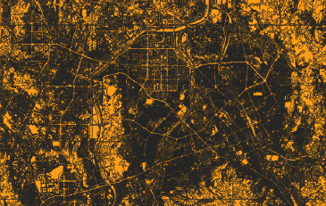
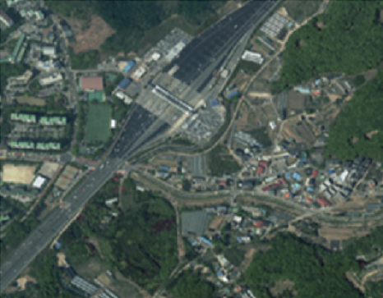





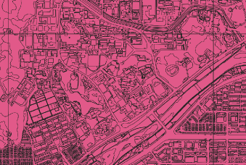
Implementation
Yolo Segmentation
We apply a Super-Resolution technique as a preprocessing step to achieve better detection performance
We fine-tuned YOLO model using satellite images tiled at zoom level 18, creating segmentation labels and training with roughly 2,000 samples per class. After training, we applied the model to Daejeon satellite imagery and successfully extracted the target features.

Slide 6
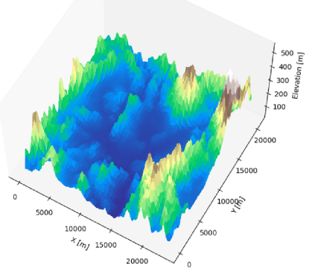

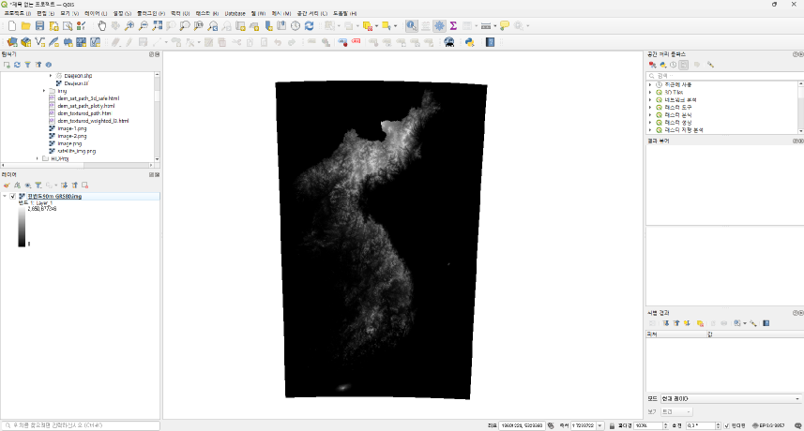
DCT Transformation
We obtained elevation data from the ‘공공데이터포털’, but because it was low-resolution 90 m data, we applied a DCT-based transformation. To match the land-cover map’s coordinate system, we converted it to EPSG:3857 and then extracted the Daejeon region for further processing.
공공데이터포털 (https://www.data.go.kr/)

Slide 7


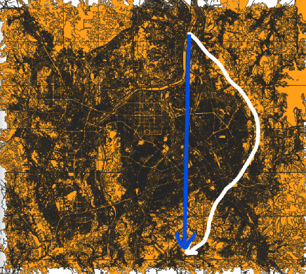
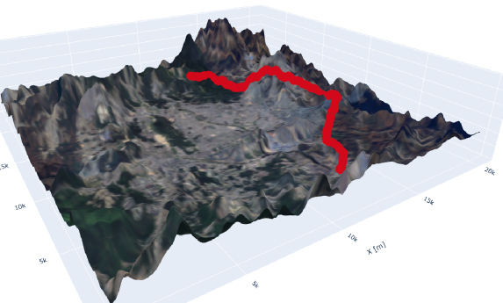






Path Finder (A* Algorithm)
We manually customized the weight values of each layer according to how difficult it is for a person to access during an emergency. By combining these weights with the YOLO-segmentation-derived layers, we could utilize the A* algorithm to find the path that minimizes the integration of the weight.

Slide 8
Conclusion
Using satellite imagery and DEM data, we developed a terrain-based optimal evacuation route system for military personnel and civilians in wartime.
Unlike conventional shortest-distance methods, the system considers terrain, passability, risk, and time efficiency to generate realistic optimal routes.
Shapefiles are extracted through object detection.

Slide 9
Expected effect
Enhanced military operations and troop protection
Improved civilian evacuation and humanitarian assistance
Expansion of a smart route system based on battlefield situational awareness
Automated information updating at national and battlefield scales

Slide 10
Thank you

